Slide 1



hwdbg
Debugging Hardware Like Software
Mohammad Sina Karvandi *, Soroush Meghdadizanjani **, Saleh Khalaj Monfared ***, Erik van der Kouwe *, Asia Slowinska *
* Vrije Universiteit Amsterdam (VUSec), The Netherlands
** Stony Brook University (SBU), United States
*** Worcester Polytechnic Institute (WPI), United States
EuroSec 2025

Slide 2
“To err is human, to debug is divine.”

Slide 3
Hardware Debugger
Debugging Hardware like Software
3

Slide 4
Key (must-have) Software Debugger Features
Memory
Registers
Reading or Writing Memory
Inspecting or Modifying Registers Values
Breakpoint
Stepping
Putting Breakpoints and Pausing The Debuggee
Stepping Through Instructions
4

Slide 5
Mapping Software Concepts to Hardware
Cutting The Signals Based on Conditions
Logic Analyzer
Signal Inspection and Modification
Emulation of Instruction Stepping by Controlling Clock Signal
Inspecting/Modifying Registers Values
Stepping Through Instructions
Reading/Writing Memory
Putting Breakpoints and Pausing The Debuggee
5

Slide 6
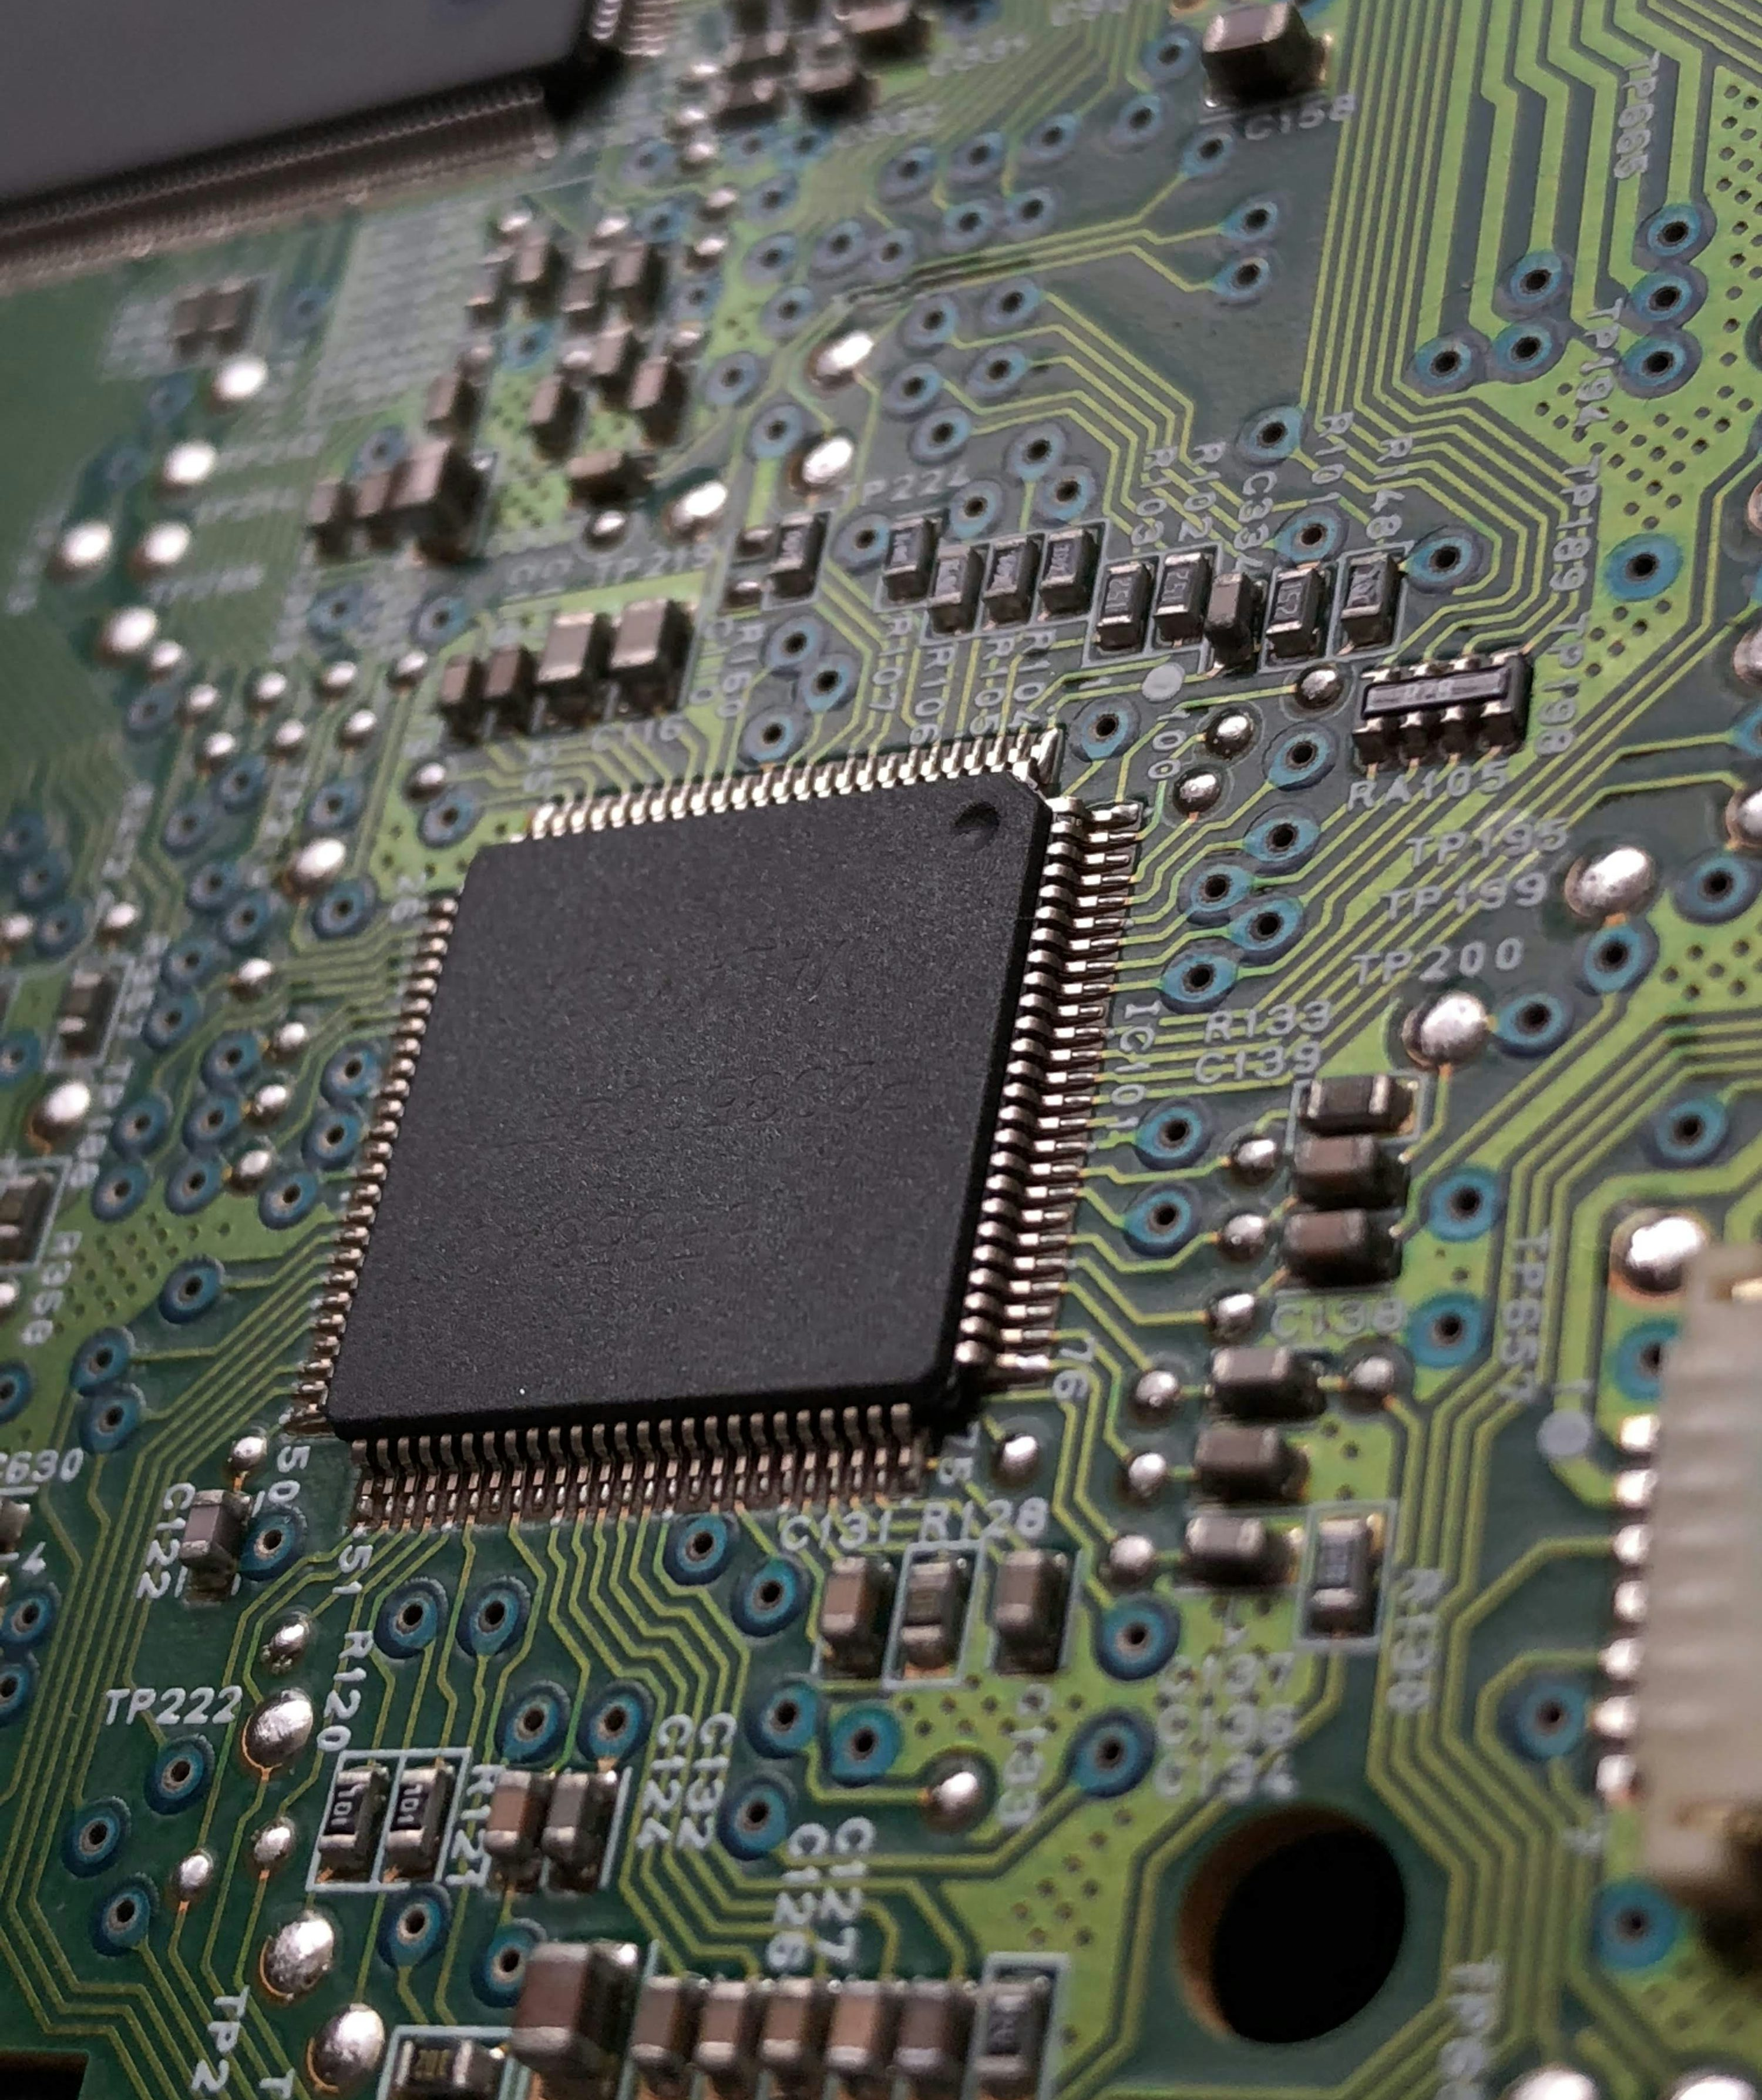
Key Intuition
Allow security researchers and hardware engineers to run custom actions
Run in smallest (shortest) event in digital circuit: rising and falling edge of the clock cycle
6

Slide 7




hwdbg is a debugger chip generator based on chisel language (scala) & LLVM circt
7

Slide 8
Key Features
Signal Analyzer
Testing & Fuzzing
Software Abstractions
Signal Manipulator
Open-source logic analyzer
Automatic testing and fuzzing chips with software-generated test cases
Simulate software debugging concepts in hardware
Not just a passive debugger, it can actively modify signals
Manipulating digital signals by changing the state of wires
8

Slide 9
Why do we need hwdbg for security?
change clock domain
fuzzing
cut signal
hardware side channels
fault injection
using PWM with different duty cycles
remove signal at random stages
reverse engineering
9

Slide 10
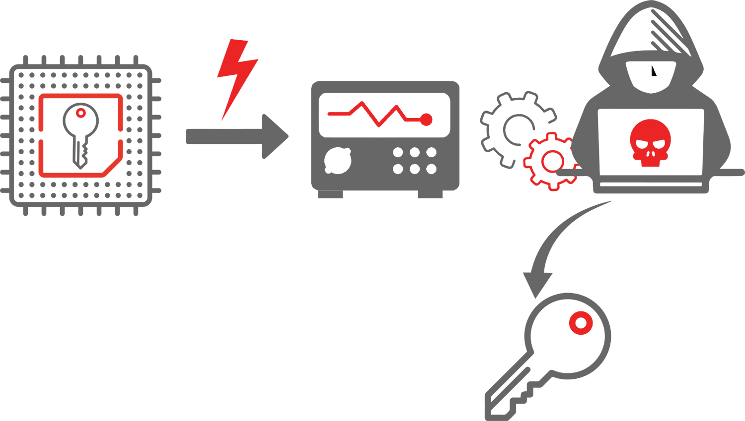
What are hardware side channels?
Side-channel attacks in chips and IP cores
- Exploit indirect information leakage (e.g., power consumption, electromagnetic emissions)
- Used to extract sensitive data
Detection using sensors
- Ring Oscillators (RO) are used for monitoring
- Detect variations in hardware characteristics
- Identify potential side-channel leakage or attacks
Hardware side channels often use debugging signals
10

Slide 11
Debugging Sensors
Ring Oscillator (RO)
IDELAYE2/3
Time-to-Digital Converter (TDC)
Measures variations in signal propagation delay to detect changes in environmental conditions or circuit behavior
Provides adjustable signal delay capabilities for timing adjustments and alignment in high-speed circuits
Converts time interval between two events into digital value for precise timing measurements
11

Slide 12
Debugging Sensors (cont.)
Voltage Sensor
Frequency & Clock Sensors
Temperature Sensor
Monitors and measures voltage levels within circuit to ensure stable and correct operation
Monitors frequency and stability of clock signals to ensure they remain within expected range and performance criteria
Measures temperature within chip to monitor thermal conditions and prevent overheating
12

Slide 13

hwdbg is available at: https://url.hyperdbg.org/hwdbg-repo Documentation: https://hwdbg.hyperdbg.org/docs
13

Slide 14
Backup!
Backup slides…
14

Slide 15

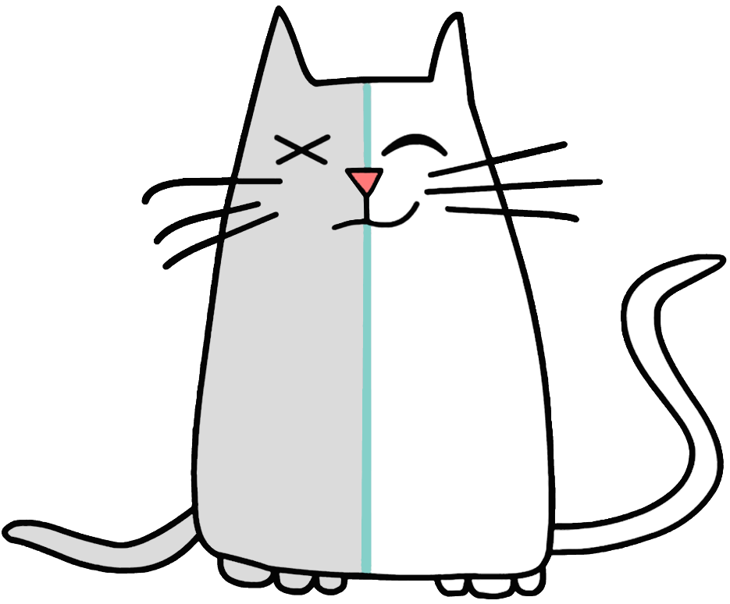
What is HyperDbg?
HyperDbg is an open-source platform that brings debugging infrastructures like hypervisor-assisted, user-mode, and kernel-mode debuggers mainly with a focus on using modern hardware technologies for analyzing, fuzzing, and reversing.

Slide 16
Key Contributions
Introduction of a Unified Debugging Framework
Open-source and Customizable Tool
Integration with FPGAs
Robust Debugging Experience
Enhancement of Reverse Engineering and Chip Fuzzing Capabilities
Comprehensive Scripting Support
hwdbg comes with these contributions.
16

Slide 17
01
02
03
Software
Hardware
Platform
The software side is implemented in C/C++ for sending debugging commands and parsing scripts.
The hardware side will be written in chisel programming language as well as Verilog and SystemVerilog.
The testing platform is AMD Xilinx FPGAs.
17

Slide 18
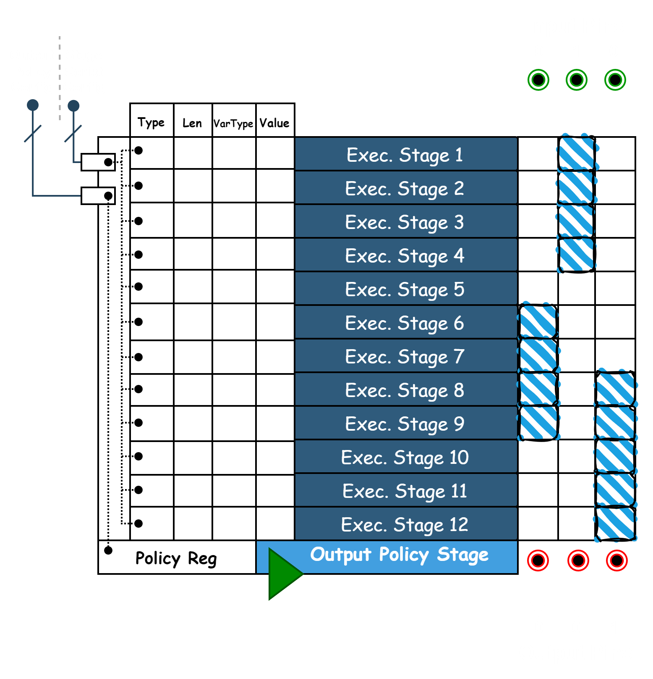
Script Execution Stages
This picture demonstrates the execution of different IR scripts in each stage.
18

Slide 19
Debugging Modes
Passive debugging
Active debugging
In this debugging mode, hwdbg acts as an introspection tool, and monitors different signals to the target debugging module.
In this debugging mode, hwdbg is able to both monitor and manipulate signals (Input/Output). These signal modifications are configured by the user’s custom scripts.
19

Slide 20
Communication Modules
—Sending Module
—Receiving Module
—Send/Receive Synchronization Module
—Interpreting Module
Sending module is responsible for preparing mandatory headers and write to BRAM as well as interrupting PS.
Once share PS <> PL line is high, receiving verifies BRAM data headers and notifies interpreter.
Because only one BRAM port is shared with PL, synchronization is needed to avoid data corruption in case of simultaneous writes.
Once a valid packet is received, the interpreting module configures the chips and sends the response to the debugger.
20

Slide 21
Physical Unclonable Function (PUF)
What is PUF?
A PUF is a physical entity utilized in microchips and other electronic devices to generate unique, device-specific cryptographic keys based on the uncontrollable physical variations that occur during the manufacturing process.
What is special about PUFs?
These unique differences, such as variations in silicon pathways, ensure that each PUF is unique and make it theoretically impossible to duplicate or clone.
21

Slide 22
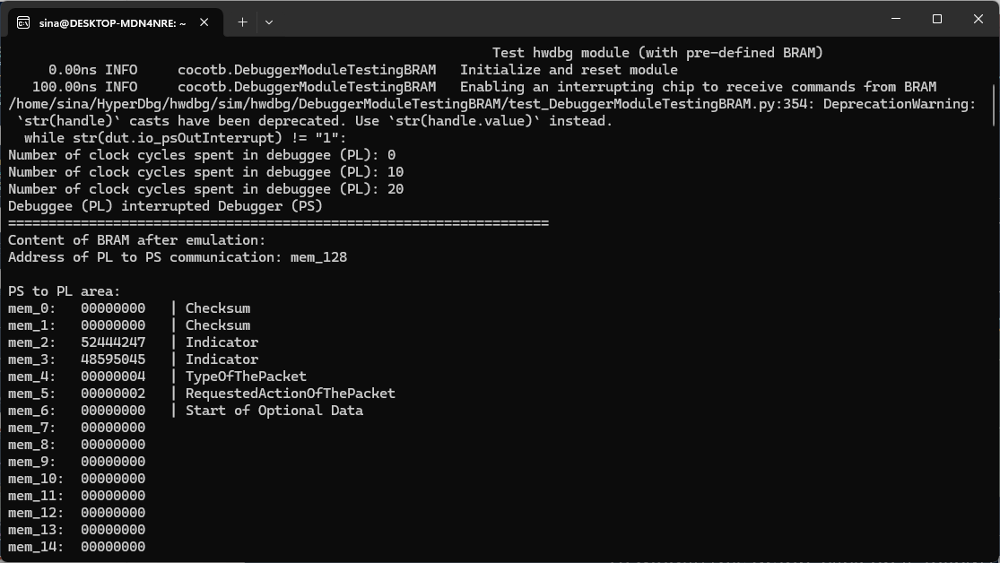
BRAM Simulator
Here is the BRAM simulator (PS to PL area).
22

Slide 23
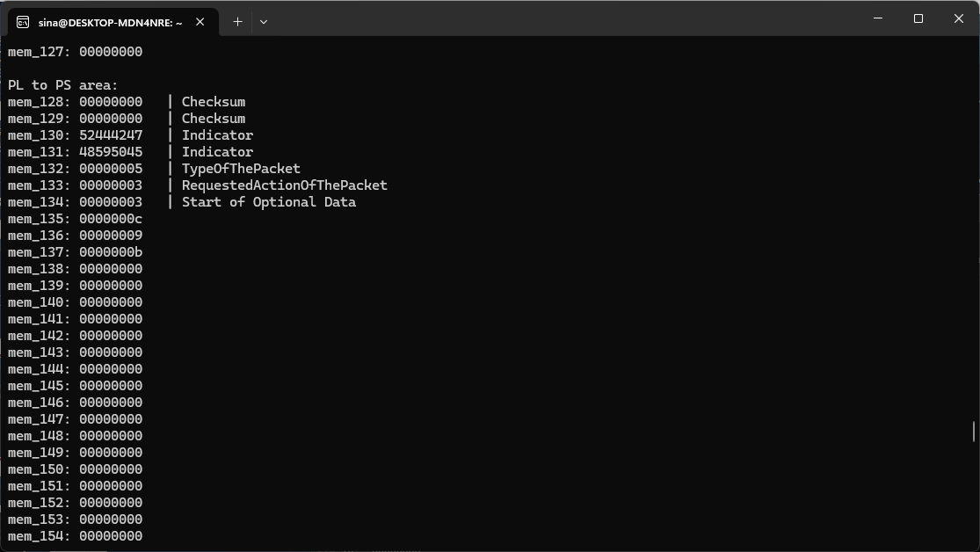
BRAM Simulator (cont.)
Here is the BRAM simulator (PL to PS area).
23

Slide 24
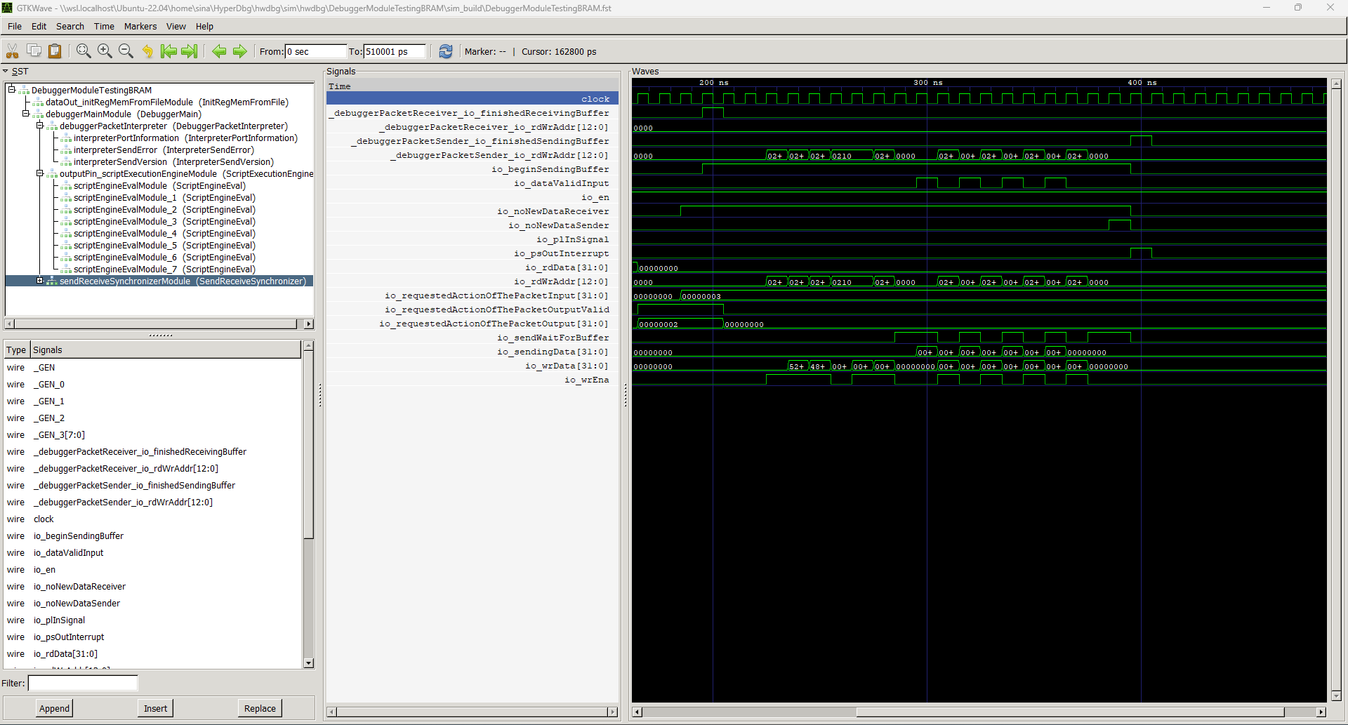
BRAM Simulator Waves
Here is the BRAM simulator wave results for hwdbg.
24

Slide 25
Anomaly Definition
Anomalies In Expected Functionalities
Anomalies Based On Sensors Indications
These occur when the device fails to compute the correct output due to specific inputs, detectable through emulation.
Sensors can indicate anomalies through abnormal state changes, signaling potential internal issues in the chip.
25

Slide 26
Supported Operators
Precedence | Operators
Parentheses | ( )
Unary Operators | -, +, ~, &, *
Arithmetic Operators | *, /, %
Arithmetic Operators | +, -
Shift Operators | >>, <<
Comparison Operators | >=, <=, >, ==, !=
Bitwise AND Operator | &
Bitwise XOR Operator | ^
Logical AND Operator | &&
Logical OR Operator | ||
26

Slide 27
dslang vs TSM
 | hwdbg (dslang) | Xilinx ILA (TSM)
Can act as a logic analyzer | Yes | Yes
Speed comparison | Slower | Faster
Can trigger an event (e.g., a breakpoint) | Yes | Yes
Has debugging sensors | Yes | No
Can modify signals on the fly (configurable) | Yes | No
Can interpret complex computations | Yes | No
Supports on-the-fly configuration | Yes | No
Notify the debugger without triggering event | Yes | No
Supports software stepping | Yes | No
Simplicity of state machine scripting | Simpler, software-like scripting | More complex
Can perform stepping fault-injection and signal manipulation | Yes | No
Can perform active debugging (producing fuzzing signals) | Yes | No
27

Slide 28
Example Script 1
? {
if (@hw_port5 == 55) {
printf(“@hw_port5 is equal to 0x55\n");
}
elsif(@hw_port5 == 66) {
printf(“@hw_port5 is equal to 0x66\n");
}
elsif(@hw_port5 == 77) {
printf(“@hw_port5 is equal to 0x77\n");
} else {
printf(“@hw_port5 is not equal to 0x55, 0x66, 0x77. It is equal to %llx\n", @hw_port5);
}
}
28

Slide 29
Example Script 2
? {
int my_func1(int var1) {
result = var1 + 1;
printf("my_func1 %d\n", result);
return result;
}
int my_func2(int var1) {
result = var1 * 2;
printf("my_func2 %d\n", result);
return result;
}
int my_func3(int var1) {
result = my_func1(var1) + my_func2(var1);
printf("my_func3 %d\n", result);
return result;
}
printf("%d\n", my_func3(2));
}
29

Slide 30
Software Stepping in Hardware
- Once we can control the clock signal, we are able to see and modify I/O ports at each cycle.
- The next rising-edge clock will be inserted once the introspection/modification is done.
- Not possible in chips with internal clock sources.
30

Slide 31
Thanks!
Do you have any questions?
m.s.karvandi@vu.nl
vusec.net
Please keep this slide for attribution

